Slide 1
TEMPO Mission Update
Kevin Daugherty
TEMPO Project Manager

Slide 2
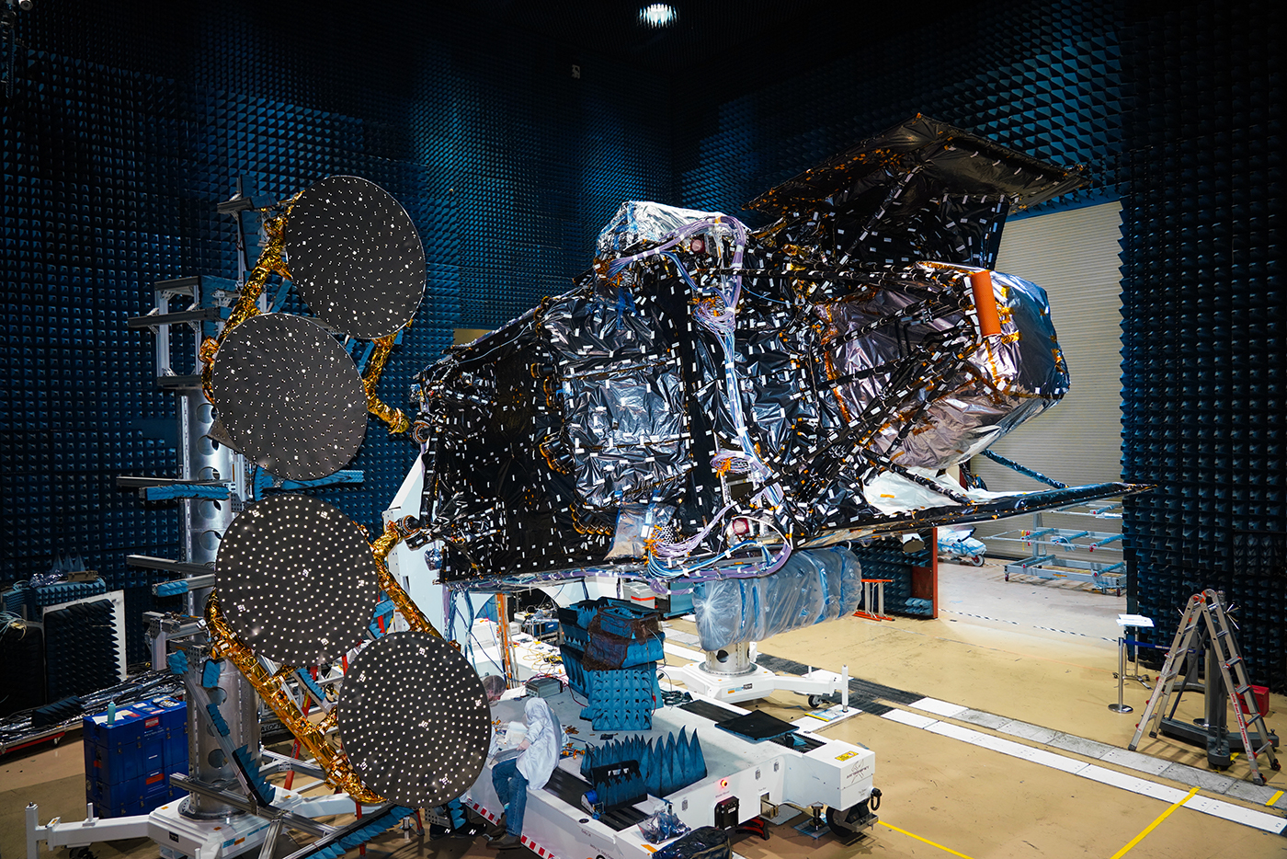
TEMPO Ground Testing
TEMPO
TEMPO shown integrated on Intelsat’s IS-40e spacecraft
(Photo Credit: Maxar Technologies)

Slide 3
Major Lifecycle Reviews
Operational Readiness Review (ORR)
Evaluates the readiness of the TEMPO project to launch and begin commissioning
Part 1 was held February 7-8, 2023 – evaluated readiness based on current status of ground testing and operations planning
Part 2 will be held May 17, 2023 – evaluates final readiness to power-on the TEMPO instrument on-orbit
Post-Launch Acceptance Review (PLAR)
Evaluates the results of commissioning and readiness to begin normal operations
Currently projected for October 2, 2023

Slide 4
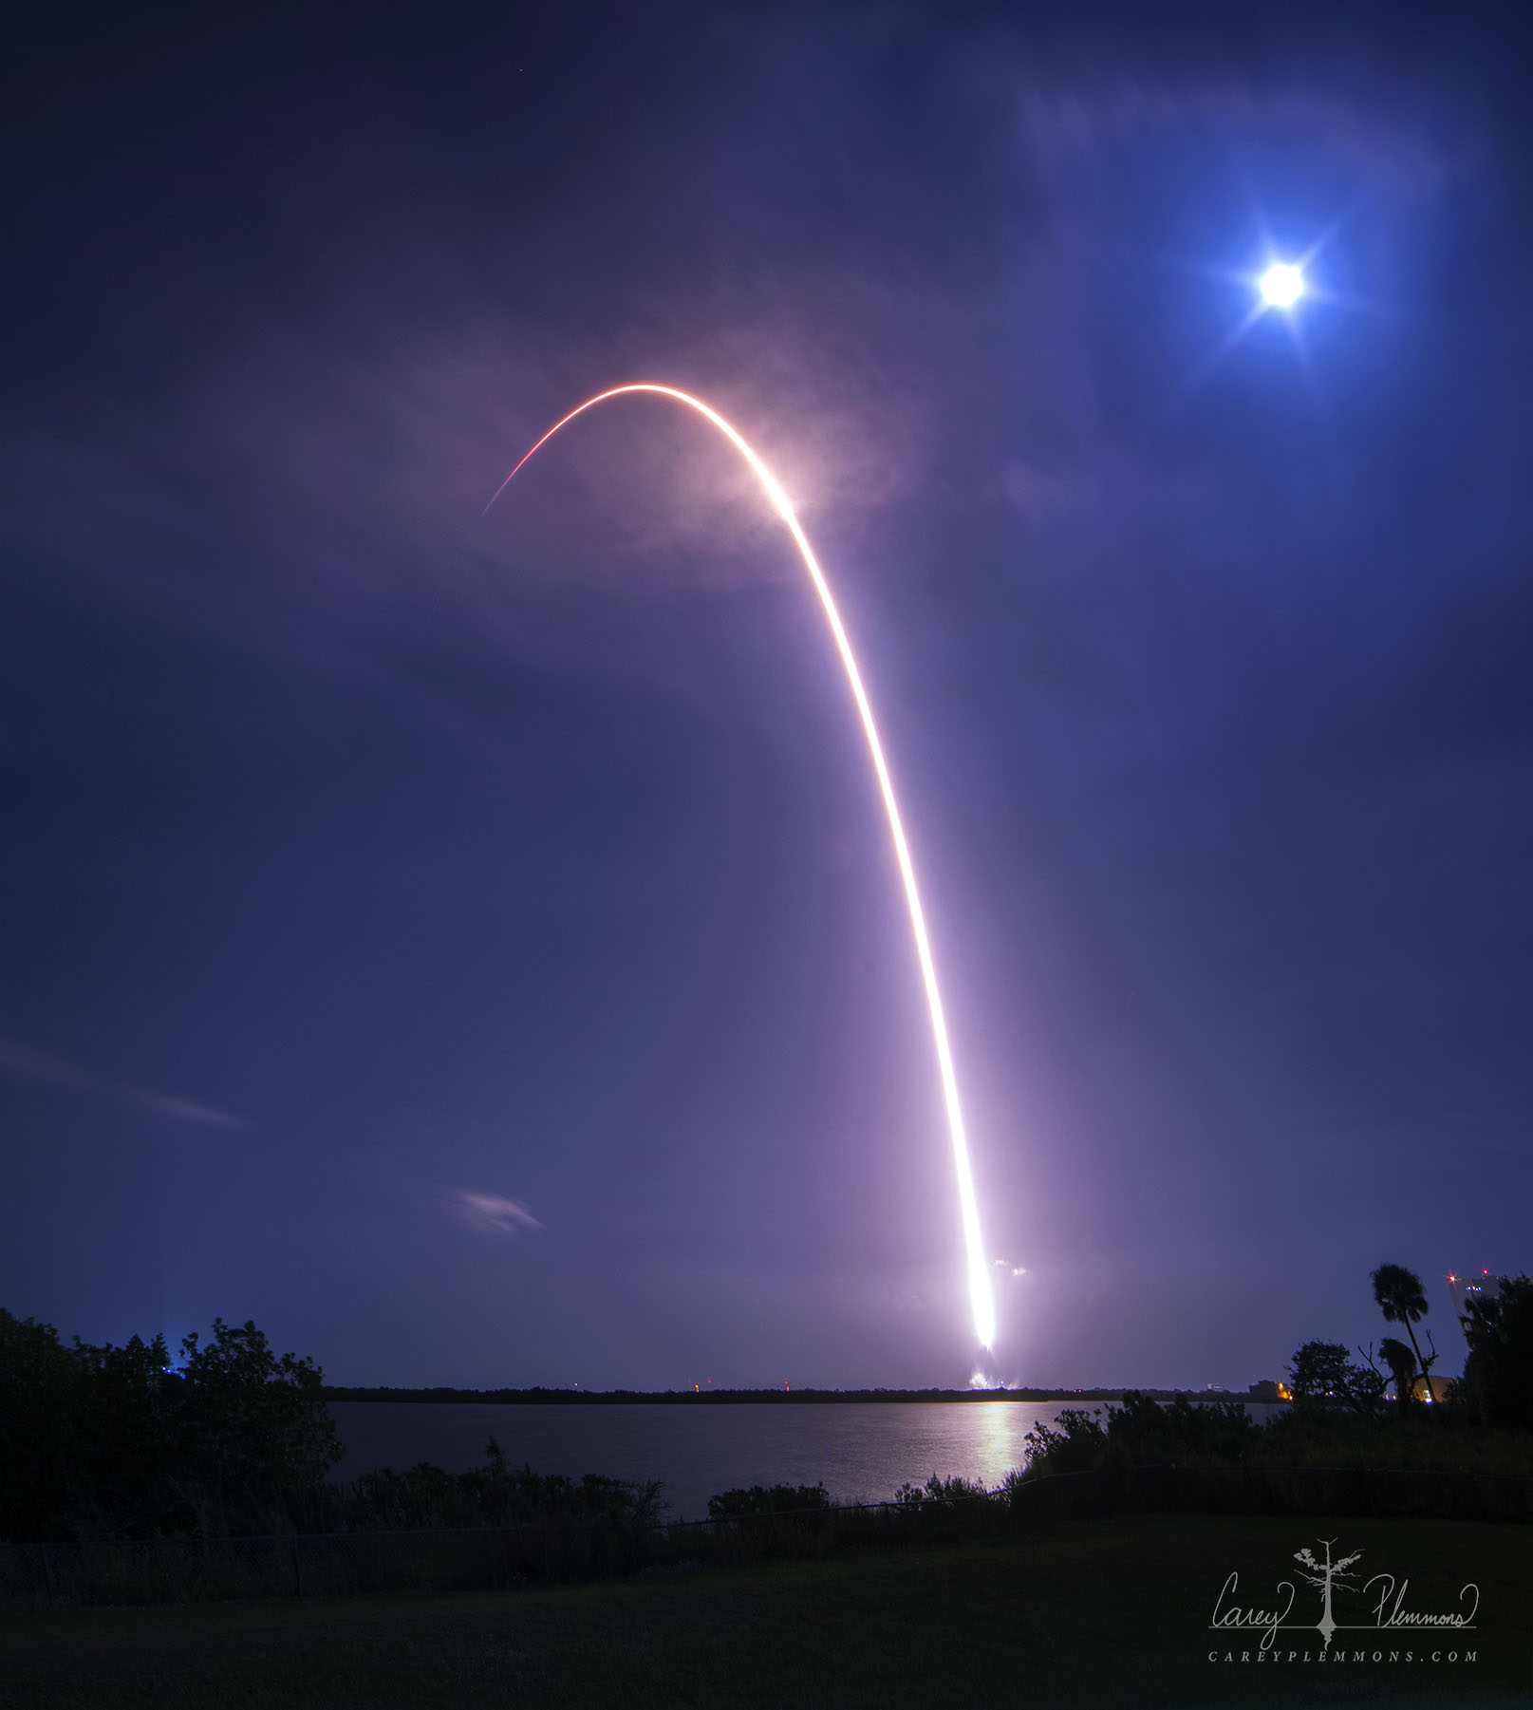
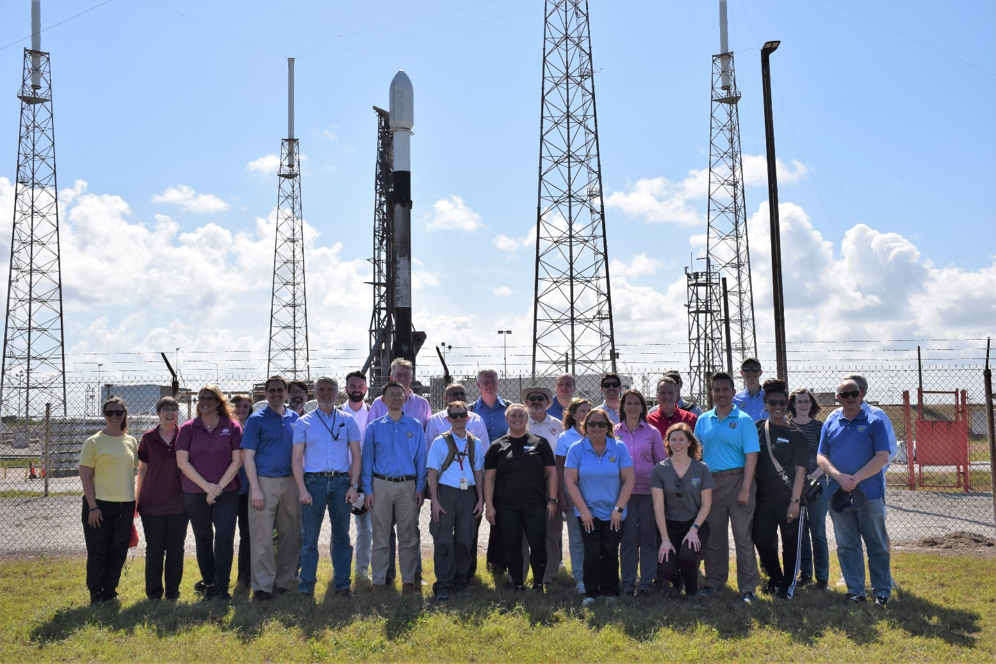
TEMPO Launch
TEMPO was successfully launched on April 7, 2023 at 12:30am
SAO and NASA TEMPO Team Members At Launch Pad
TEMPO Launch (Photo Credit: Carey Plemmons)

Slide 5
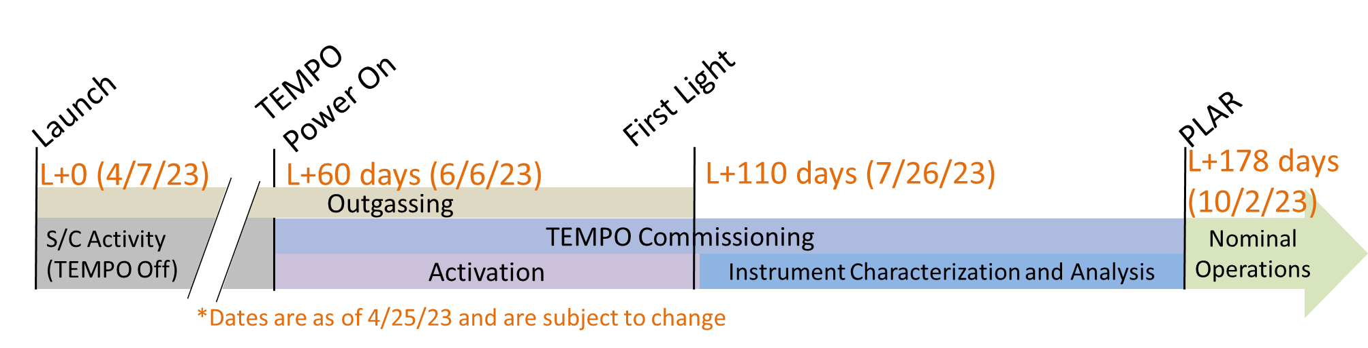
Commissioning Timeline
IS-40e will be checked out at 91.0W longitude before TEMPO commissioning begins
Commissioning has two parts, Activation and Instrument Characterization and Analysis
Once commissioning begins, First Light and the opening of the Calibration Wheel will not occur until the S/C has outgassed for approximately 110-120 days since launch
Normal operations and data processing will begin approximately 6 months after launch
Data will begin to be publicly available within 2-6 months after PLAR (8-12 months after launch) depending on the level of data product
Details of the commissioning activities are captured in the TEMPO Commissioning Plan and TEMPO Commissioning Timeline

Slide 6
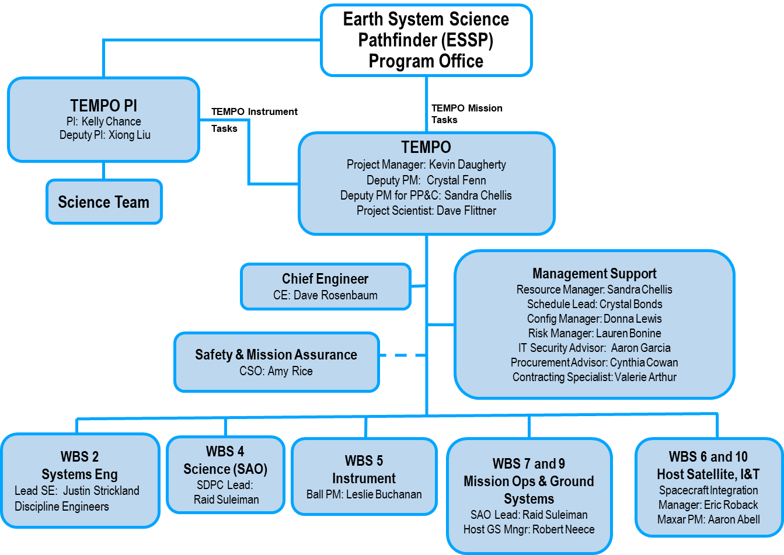






TEMPO Project Organization

Slide 7
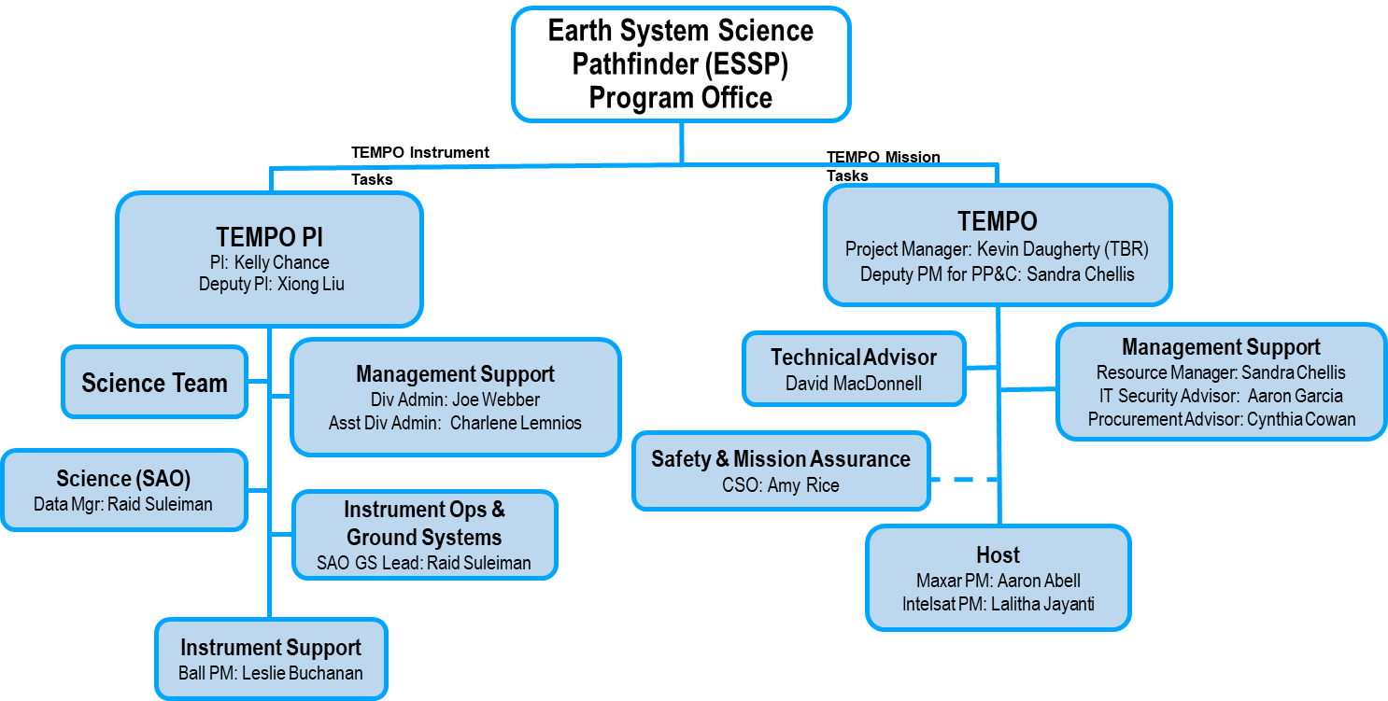
TEMPO Project Organization Post PLAR

Slide 8


